Slide 1
Lecture 11.1 Individual Performance Evaluation

Slide 2
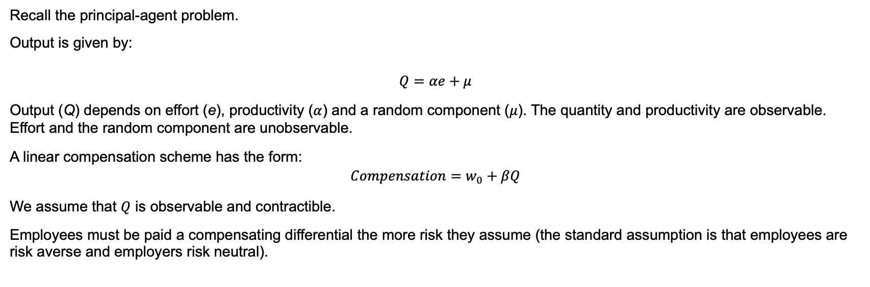
Individual Performance Evaluation
Recall the principal-agent problem.
Output is given by:
$$Q=αe+μ$$
Output (Q) depends on effort (e), productivity ($α$) and a random component ($μ$). The quantity and productivity are observable. Effort and the random component are unobservable.
A linear compensation scheme has the form:
$$Compensation=w_{0}+βQ$$
We assume that $Q$ is observable and contractible.
Employees must be paid a compensating differential the more risk they assume (the standard assumption is that employees are risk averse and employers risk neutral).

Slide 3
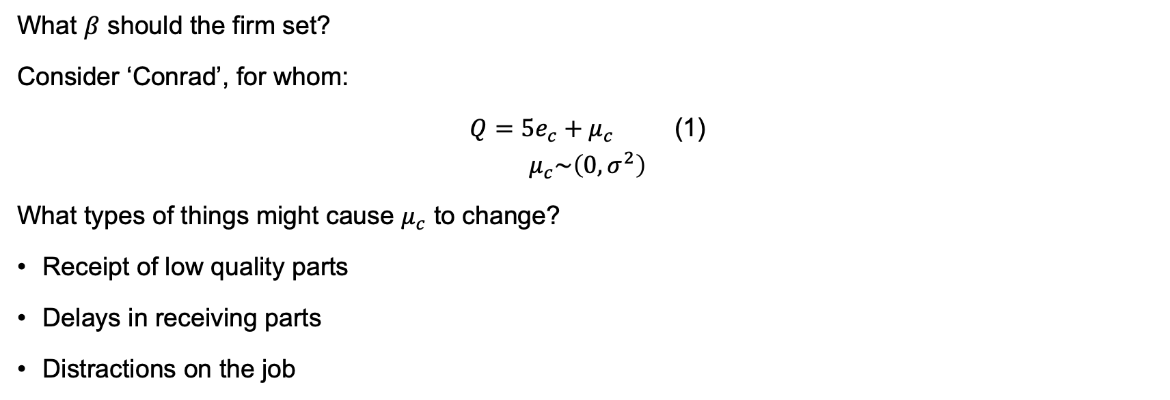
Individual Performance Evaluation
What $β$ should the firm set?
Consider ‘Conrad’, for whom:
$Q=5e_{c}+μ_{c}$ (1)
$$μ_{c}\sim \left(0,σ^{2}\right)$$
What types of things might cause $μ_{c}$ to change?
Receipt of low quality parts
Delays in receiving parts
Distractions on the job

Slide 4
Individual Performance Evaluation
What might you do if (1) is unknown?
You might use a ‘time and motion’ study:
Might have to be redone periodically
Expensive
Potential bias
Analysis of historical data:
Leads to a perverse incentive associated with the ‘ratchet effect’ associated with basing this year’s standard of performance on last year’s performance

Slide 5
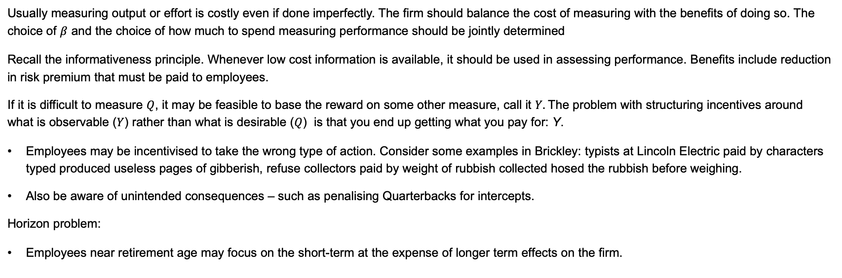
Measurement
Usually measuring output or effort is costly even if done imperfectly. The firm should balance the cost of measuring with the benefits of doing so. The choice of $β$ and the choice of how much to spend measuring performance should be jointly determined
Recall the informativeness principle. Whenever low cost information is available, it should be used in assessing performance. Benefits include reduction in risk premium that must be paid to employees.
If it is difficult to measure $Q$, it may be feasible to base the reward on some other measure, call it $Y.$The problem with structuring incentives around what is observable ($Y$) rather than what is desirable ($Q$) is that you end up getting what you pay for: Y.
Employees may be incentivised to take the wrong type of action. Consider some examples in Brickley: typists at Lincoln Electric paid by characters typed produced useless pages of gibberish, refuse collectors paid by weight of rubbish collected hosed the rubbish before weighing.
Also be aware of unintended consequences – such as penalising Quarterbacks for intercepts.
Horizon problem:
Employees near retirement age may focus on the short-term at the expense of longer term effects on the firm.

